Slide 1
World Cup 2023 EDA
By: Mostafa Noaman Ahmed

Slide 2
Agenda
What is Cricket
Team Performance Analysis
Player Performance Analysis
Opposition and Ground Analysis
Temporal Analysis

Slide 3
What is Cricket
Second most popular game in the world.
Is a bat-and-ball game that is popular in many countries. It is played between two teams, each consisting of eleven players.
The game is usually played on a circular field called a cricket ground.
The primary objective in cricket is to score more runs than the opposing team.
One team bats while the other bowls and fields.

Slide 4
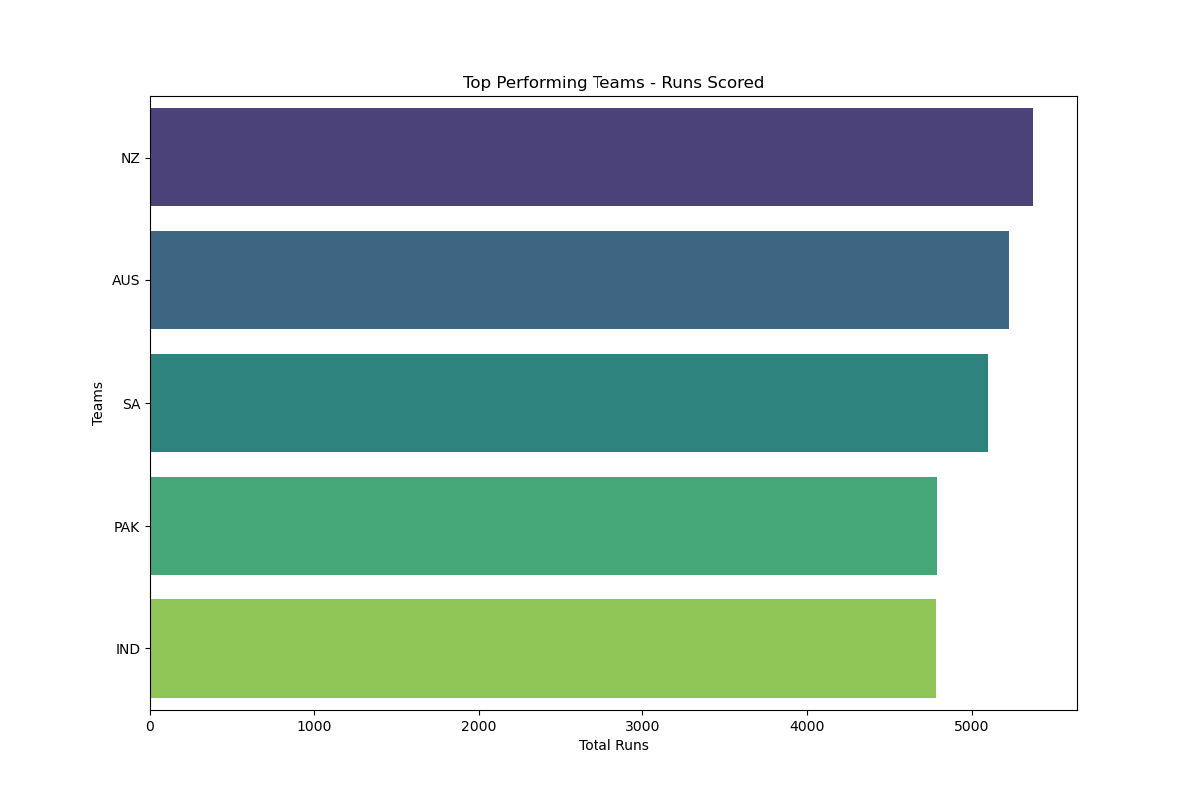
Team Performance Analysis
Shows the Total Runs for each team.

Slide 5
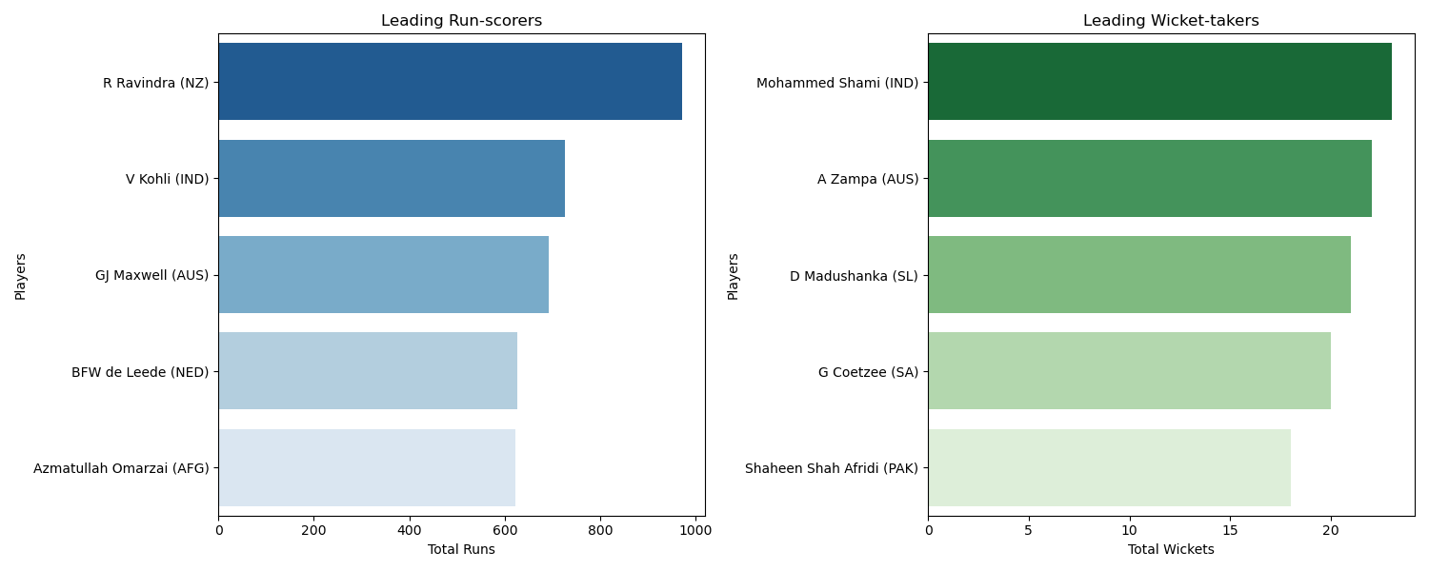
Player Performance Analysis
Left plot:
Shows the Total Runs for each player.
Right plot :
Shows the Total Wickets for each player.

Slide 6
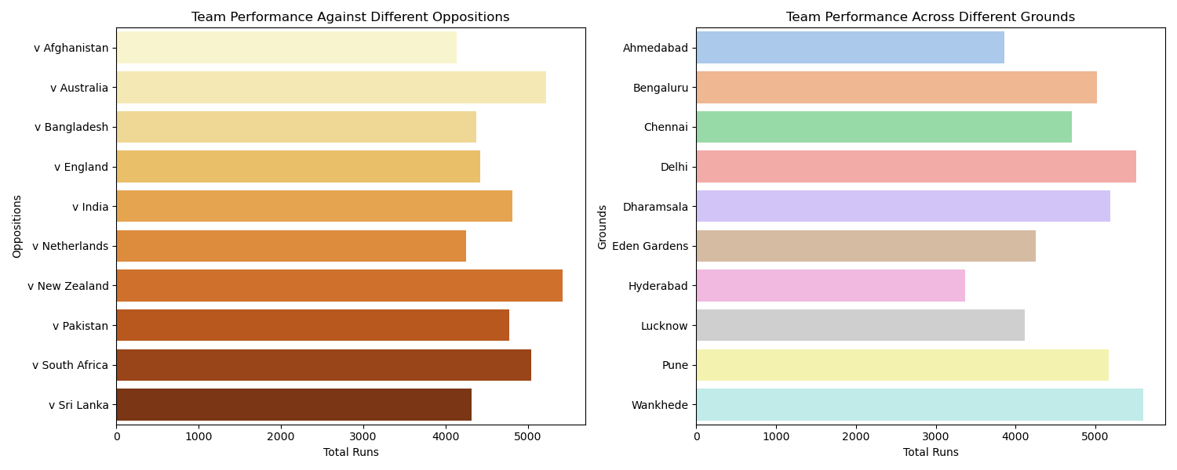
Opposition and Ground Analysis
Left plot:
Shows the Total Runs in attacks for each Team.
Right plot :
Shows the Total Runs in defenses for each team.

Slide 7
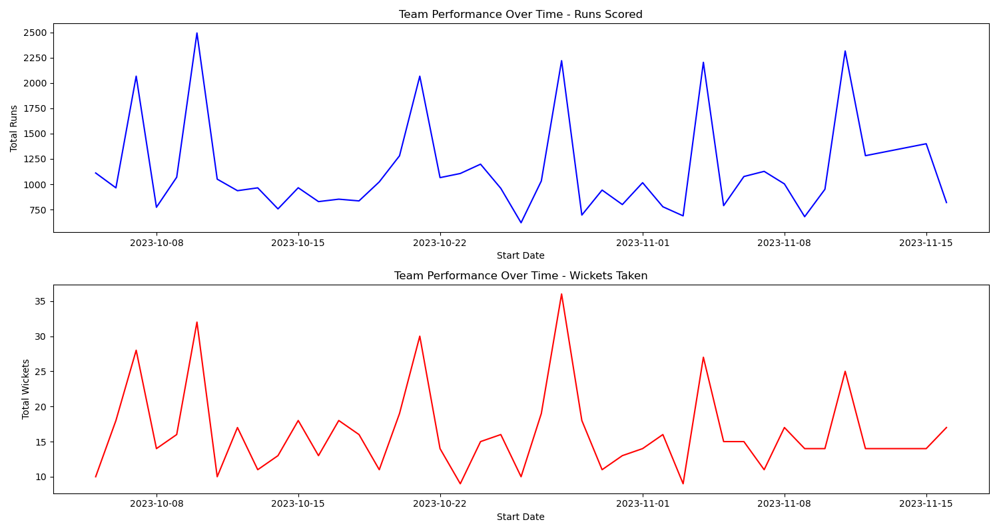
Temporal Analysis
Upper plot:
Shows Performance over time in terms of Runs scored
Lower plot :
Shows Performance over time in terms of wickets taken

Slide 8
Thank you

